Slide 1
Basic
Intermediate
Advanced
Scratch interface (you will find tutorials on the right hand side)
Blocky challenges
Code.org hour of code (different levels)
Scratch workbook
Khanacademy Tutorials & hour of code
AppInventor modules (look to the bottom of the page for chapters) App Inventor Bray dojo , breadcrumbs app
CodeAcademy tutorials
Python create game

Slide 2
PRINTOUTS
Scratch 4 modules
JavaScript Beginner Intermediate Advanced
Python Beginner Intermediate
Website building Beginner Intermediate Advanced
Mbots all modules book

Slide 3
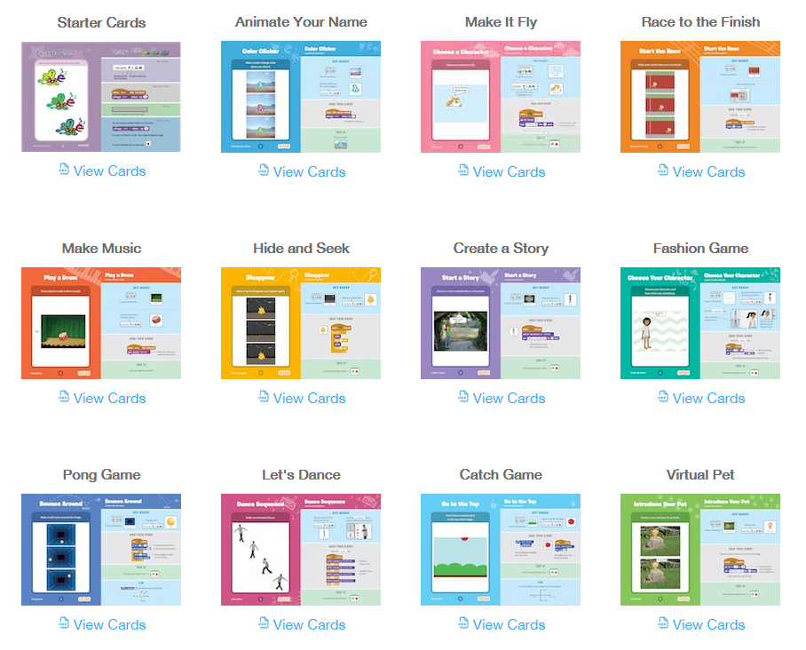
Links
Scratch cards
Link to cards

Slide 4
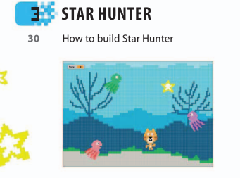
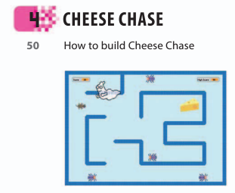
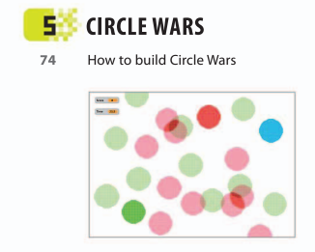
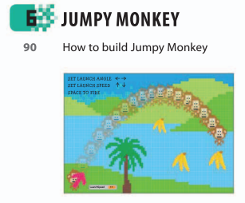
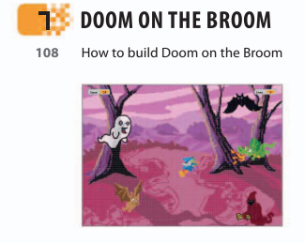
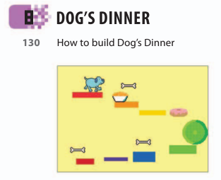

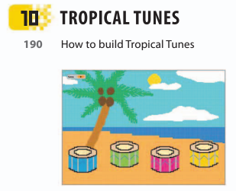
Create scratch games (Start with game #3 )
Link to scratch games

Slide 5
Arduino
SparkFun arduino guide, Inventor’s kit content

Slide 6
GOOGLE ACCOUNT FOR KIDS < 13
awesomeninjacoder@gmail.com
Hint: Be cool! ;)

Slide 7
Other Dojo Resources :)
CoderDojo London
https://coderdojo.london/resources/scratch

Slide 8

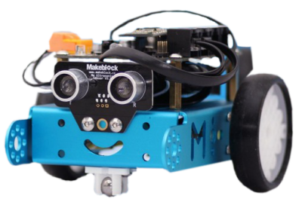

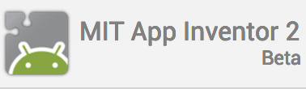




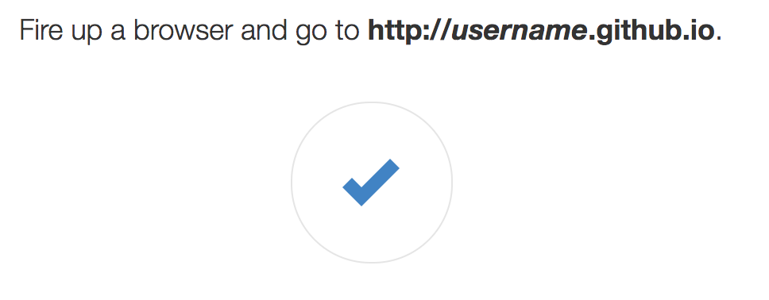
SAMPLE TRANSITION
RESOURCES TINYURL
coderdojoscratchclass
coderdojohourofcodeteacher
carltoncoderdojo@gmail.com
coderdojoscratchclassworkbook
coderdojocodecombatjsclass
coderdojocodecombatpythonclass
https://pages.github.com/

Slide 9

Break time

